Slide 1
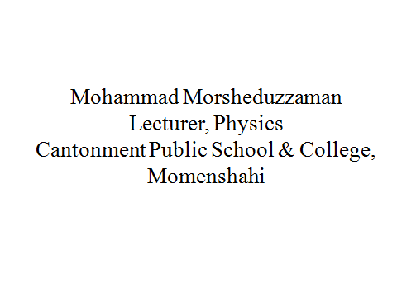
Welcome

Slide 2
Vector
Feedback
What is the scalar product?
On what condition two vectors will be perpendicular to each other?

Slide 3
Vector
Today’s class is divided into two phases
1. Vector product
2. Explanation of vector product

Slide 4
Vector
Vector product
C=A x B=n ABSin
R
Q
B
C= A x B
BSin
O
S
P
A

Slide 5
Vector
Vector product
R
Q
C = A x B = AB Sin
= OP × OR Sin
= OP × RS
= A × h
= area of parallelogram
Thus, the magnitude of vector product of two vectors equals to the area of a parallelogram taking the two vectors as adjacent sides.
BSinƟ
O
S
P

Slide 6
Vector
Vector product
^
i
×i
=n ii SinƟ
= n 1 × 1 SinƟ
= 0
j
^
^
^
^
^
^
^
i × i = j × j = k × k = 0
i
k
Again,
i × j
= n i j SinƟ
= n 1 1 Sin 90˚
= n 1
= k

Slide 7
Vector
Vector product
Similaelarly,
j
^
^
^
^
^
^
j × k = i
k × i = j
Again,
i
k
^
^
^
^
^
^
k × j = -i
j × i = -k
^
^
^
i × k = -j

Slide 8
Vector
Vector product
If the cross product of two vectors is zero, then the vectors are parallel to each other
A ×B = A B sinƟ
Or, A B sinƟ = 0
Or, sinƟ = 0
Or, sinƟ = sin0˚
Or, Ɵ = 0˚

Slide 9
Vector
Evaluation
What is vector product ?
How can you find the direction of vector product ?

Slide 10
Thermodynamics
?

Slide 11
Thermodynamics
Home work
Show that the area of parallelogram is the magnitude of vector product.

Slide 12
Thanks

